Slide 1

MEMBERSHIP WEB SYSTEM
Integration Procedure and Protocol

Slide 2


SYSTEM FLOW
Scan & pay
exchange
transfer
retrieve
exchange
POS Counter
System
Data
Network
KSC Database
Panda Server

Slide 3
API MODULE
Source System
Field Name | Max Length | Data Type | Method
Id | 100 | int | “POST”
Point | 100 | int | “POST”
receive
Target System
Panda System
Field Name | Data Type | Max Length | Method
Id | int | 100 | “POST”
Point | int | 100 | “POST”
revert

Slide 4
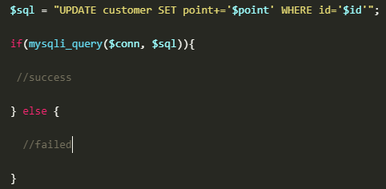

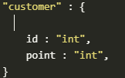
SYSTEM FUNCTIONALITY
Language : php / html
Procedure : update point
Update Database :
Create Connection :
Create Database :

Slide 5
RESOURCE
KOM.CC : Web Hosting
Direct Admin : API Platform
phpMyAdmin : Database

